Slide 1
Confounding
Confounding with a worked example of a linear model with multiple explanatory variables

Slide 2
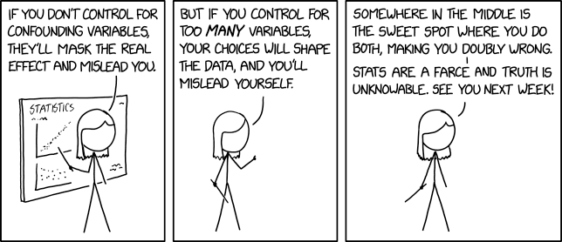

Slide 3
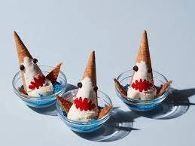


How do we understand causation?
Causal inference is the goal in most of science
  Do ice cream sales cause sharks to attack?
How do we know if there is a causal relationship?
  With a statistical model
$$Shark_{i}=0.5+5×Sales_{i}$$
$$Shark_{i}=β_{1}+β_{2}×Sales_{i}$$
Ice cream sales
Shark attack

Slide 4
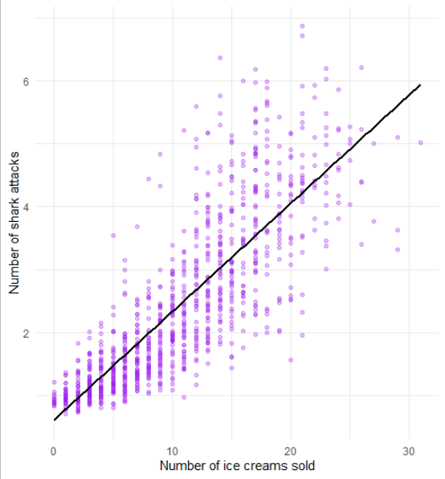

Sceptical?
How could we convince ourselves?
Plotting the raw data and prediction?
Relationship looks pretty clear cut
$$Sales_{i}×5+0.5=Shark_{i}$$
Ice cream sales
Shark attack

Slide 5
Could we think of a causal mechanism?
“Sharks smell sugar!”
“Given sharks have acute sensory organs, we propose that the increased sugar levels are detected by sharks, leading to a preferential targeting of those who recently consumed ice cream.”
$$Sales_{i}×5+0.5=Shark_{i}$$
Ice cream sales
Shark attack

Slide 6

Do models describe causation?
Always remember: models find associations between variables
Associations can be:
  Causal
  Coincidental (i.e., “spurious correlations”)
  Confounded (i.e., special types of “spurious correlations”)
$$Sales_{i}×5+0.5=Shark_{i}$$
Ice cream sales
Shark attack

Slide 7
Is this a coincidence?
In this simulated data, No
Coincidental “relationships” have no “connection”
  Purely random chance that two variables “match up”
Ice cream sales and shark attacks do have a connection
  Just not a causal one (i.e., ice cream does not cause shark attacks)
So how are they connected?

Slide 8
Any guesses?
Visit beach
Ice cream sales
Shark attack

Slide 9


Shark and ice cream connection
The arrows show the direction of causation
  People eat ice cream when they go to the beach
  People go swimming at the beach and can then be attacked by sharks
The model does not know about going to the beach, or which way the arrows go
  The model only knows what we tell it
  It could easily find that shark attacks cause ice cream sales!
Because ice cream and shark attacks are causally linked by going to the beach, the model can find a relationship
  There is an open path for the information (not causation) to flow
Visit beach
Ice cream sales
Shark attack
$$Shark_{i}=β_{1}+β_{2}×Sales_{i}$$
$$Shark_{i}=0.5+5×Sales_{i}$$

Slide 10
A family of confusion
Truth
Fork
Pipe
What we hope for
Z
Z
X
Y
X
Y
X
Y
Different types of confounding relationships
Coincidence
Collider
Descendant
Associated by chance
Z
X
Z
Y
X
Y
X
Y
V

Slide 11
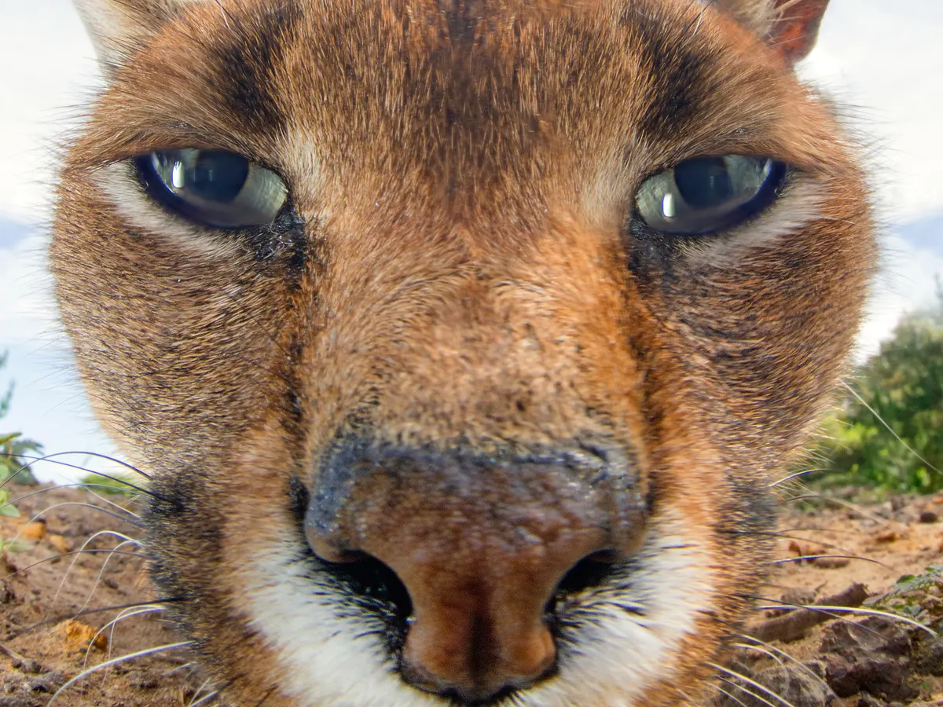
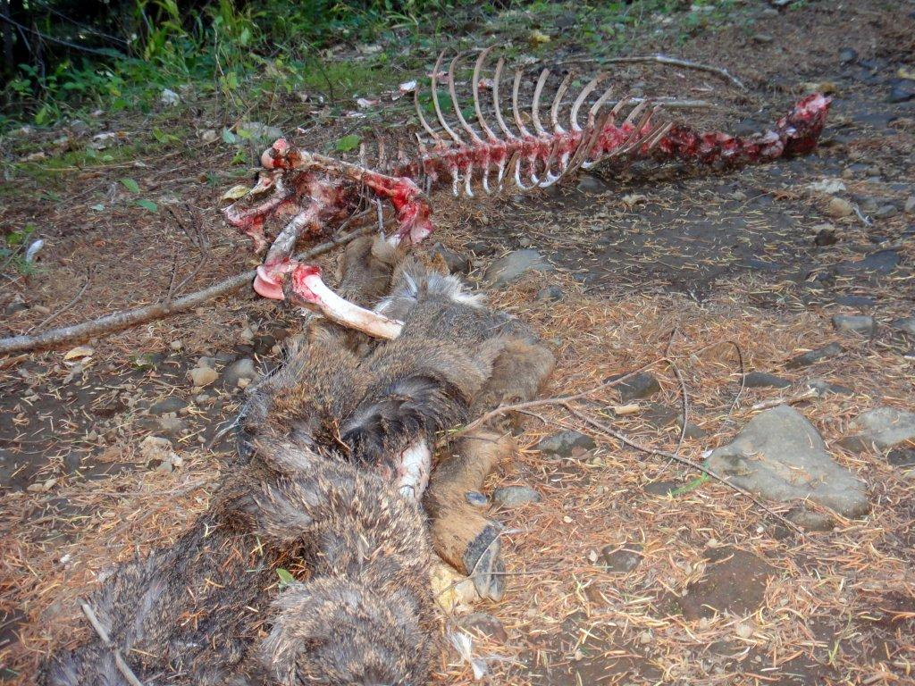
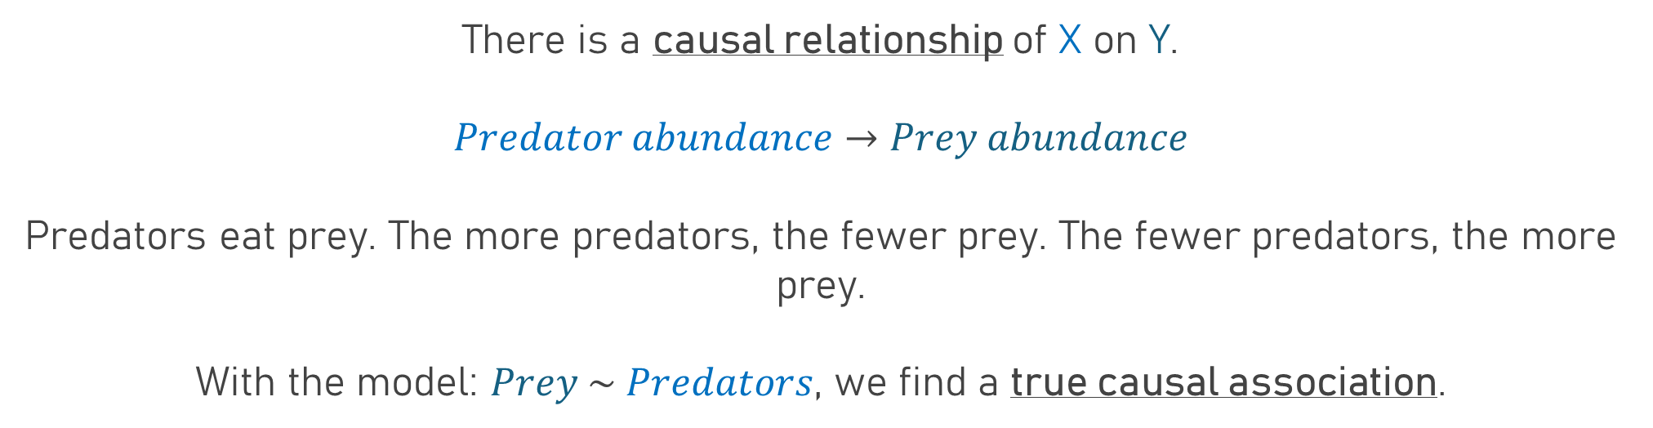
A true causal relationship
X
Y
There is a causal relationship of X on Y.
$$Predator abundance→Prey abundance$$
Predators eat prey. The more predators, the fewer prey. The fewer predators, the more prey.
With the model: $Prey \sim Predators$, we find a true causal association.
Negative effect

Slide 12
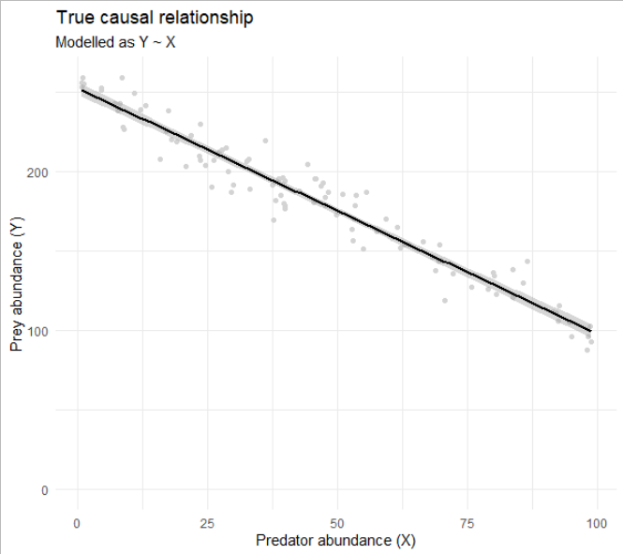
A true causal relationship
X
Y

Slide 13
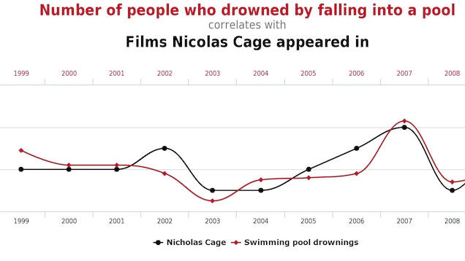
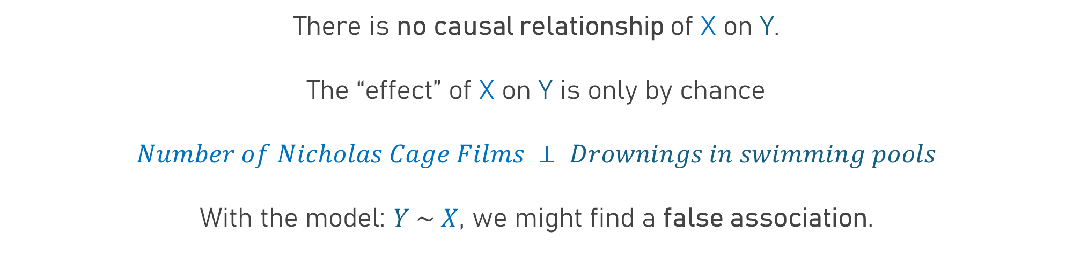
Spurious correlations
X
Y
There is no causal relationship of X on Y.
The “effect” of X on Y is only by chance
$$Number of Nicholas Cage Films ⊥ Drownings in swimming pools$$
With the model: $Y \sim X$, we might find a false association.

Slide 14
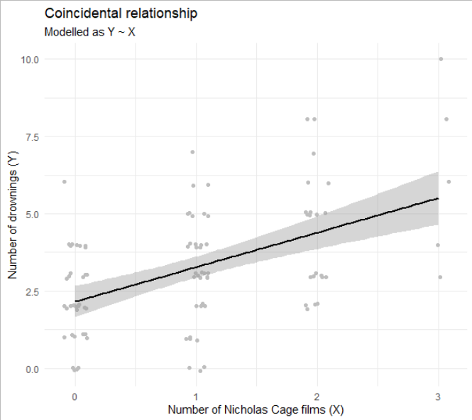
Spurious correlations
X
Y

Slide 15
The confounds
Fork
Pipe
Z
Z
In all confounds, the problem arises when we can predict Y from X when there is no causal relationship.
X
Y
X
Y
Collider
Descendant
Z
X
Z
Y
X
Y
V

Slide 16
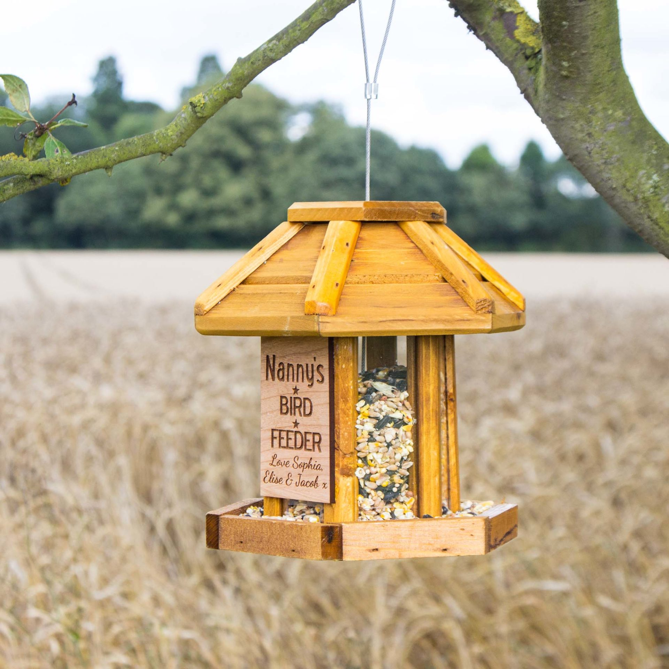
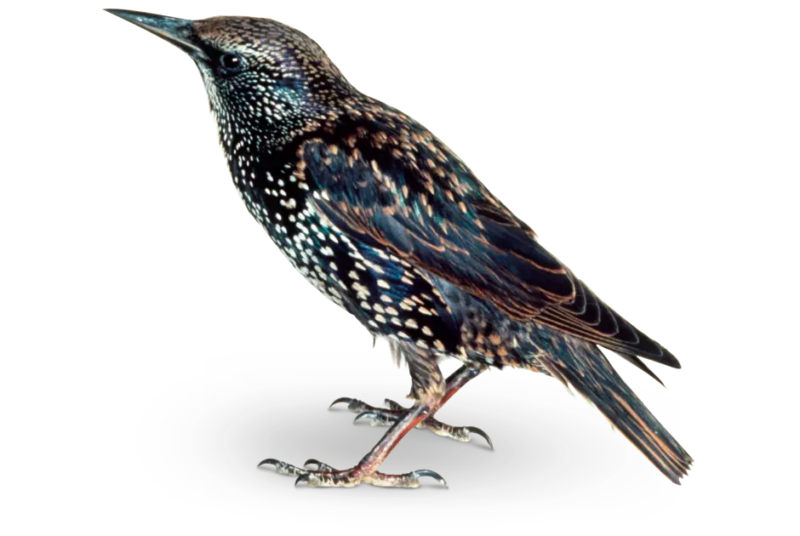
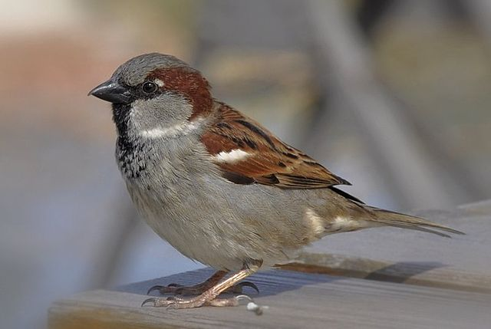
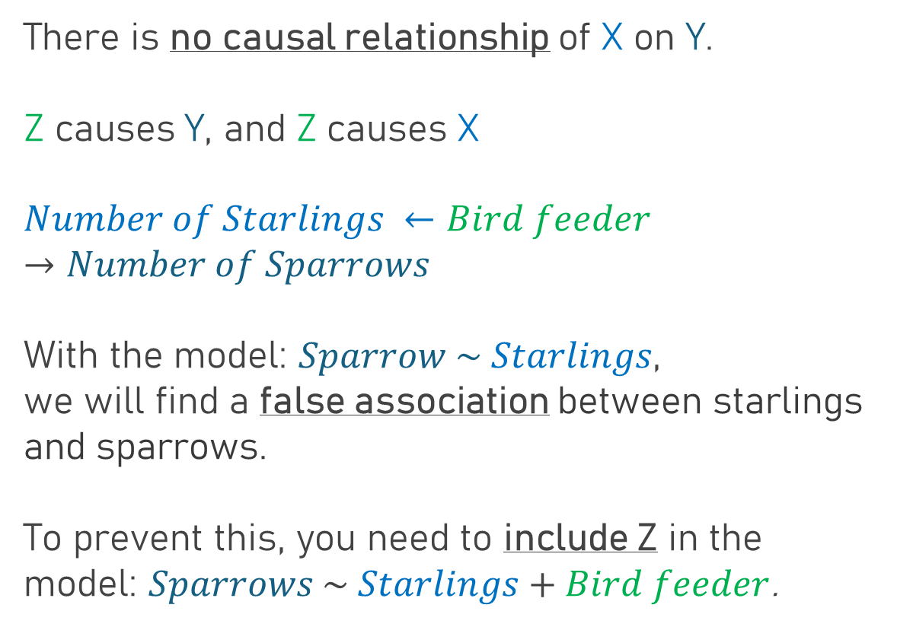
Forking confounds
Z
X
Y
There is no causal relationship of X on Y.
Z causes Y, and Z causes X
$$Number of Starlings ←Bird feeder→Number of Sparrows$$
With the model: $Sparrow \sim Starlings$,
we will find a false association between starlings and sparrows.
To prevent this, you need to include Z in the model: $Sparrows \sim Starlings+Bird feeder$.

Slide 17

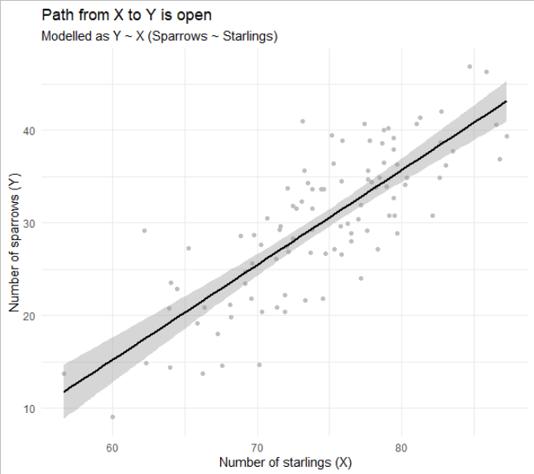
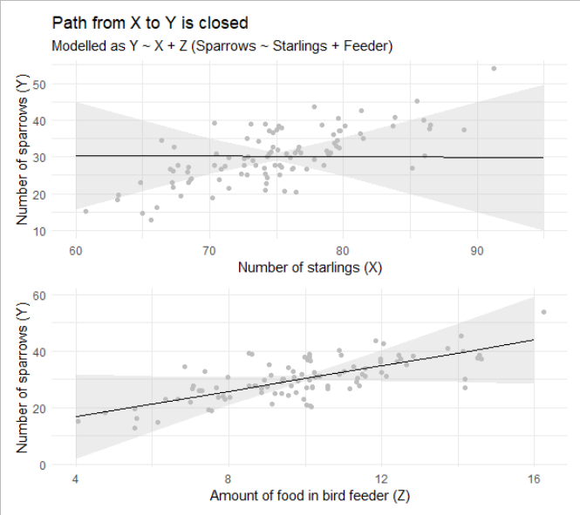
Forking confounds
Z
Z
X
Y
X
Y
Path is open
Path is closed

Slide 18

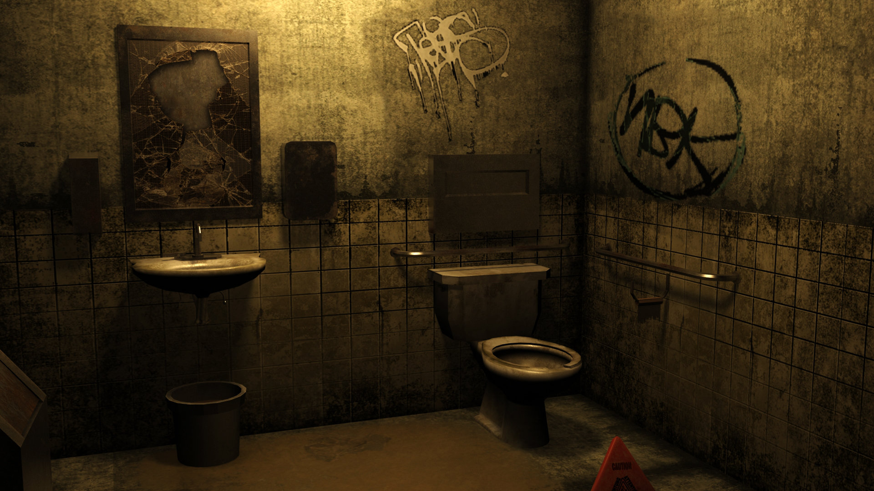



Forking confound quiz
Z
X
Y
causes (?)
$$Clean bedroom ←Clean freak→Clean toilet$$
If my bedroom is clean, what would you predict my bathroom looks like?
If we don’t want to misinterpret Clean Bedrooms as causing Clean Toilets, we need to know if the person is a clean freak.
$$=$$
$$?$$
If you knew Z, would you still misattribute clean bedrooms as causing clean bathrooms?

Slide 19
The confounds
Fork
Pipe
Z
Z
X
Y
X
Y
Collider
Descendant
Z
X
Z
Y
X
Y
V

Slide 20
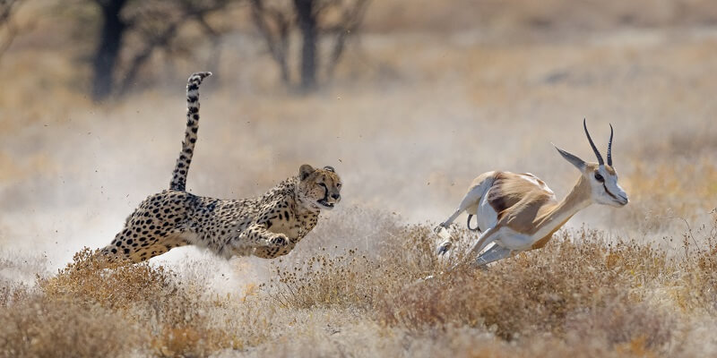
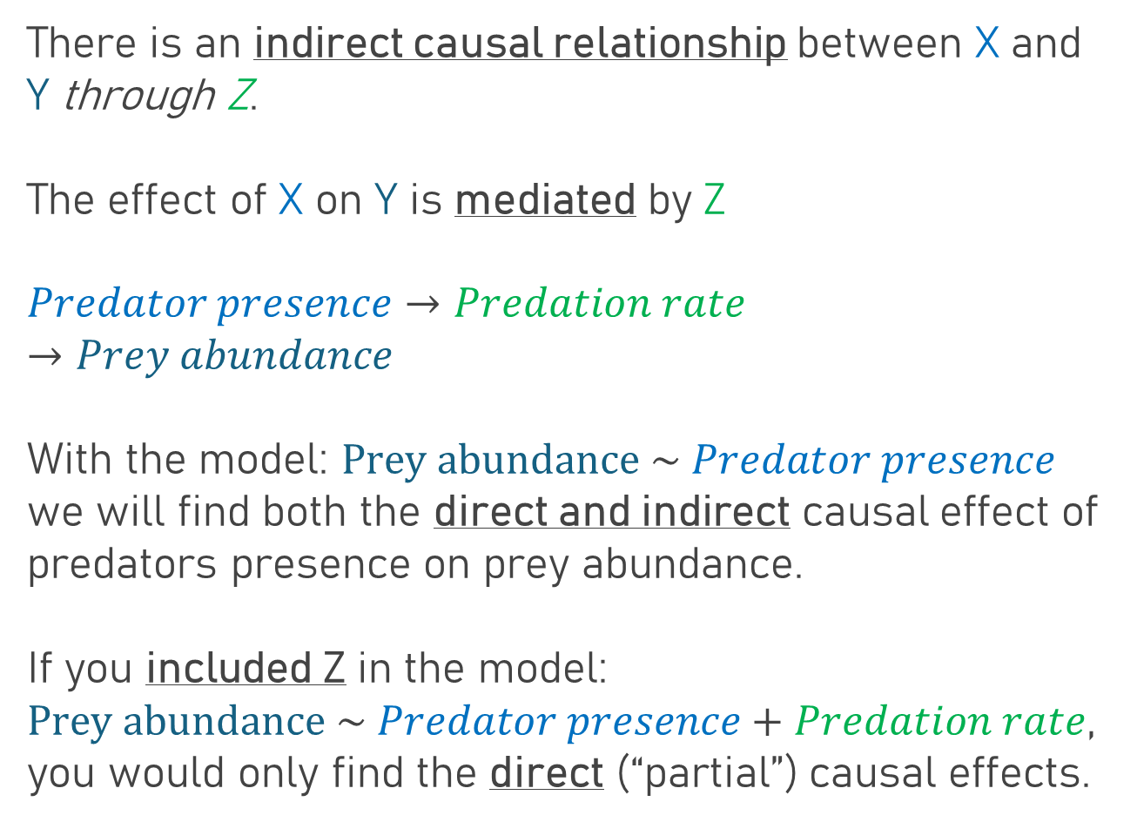
Piped confound
Z
X
Y
There is an indirect causal relationship between X and Y through Z.
The effect of X on Y is mediated by Z
$$Predator presence→Predation rate→Prey abundance$$
With the model: $Prey abundance \sim Predator presence$
we will find both the direct and indirect causal effect of predators presence on prey abundance.
If you included Z in the model:
$Prey abundance \sim Predator presence+Predation rate$,
you would only find the direct (“partial”) causal effects.

Slide 21
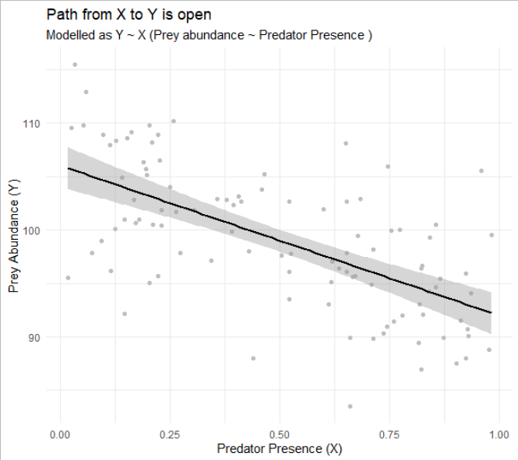
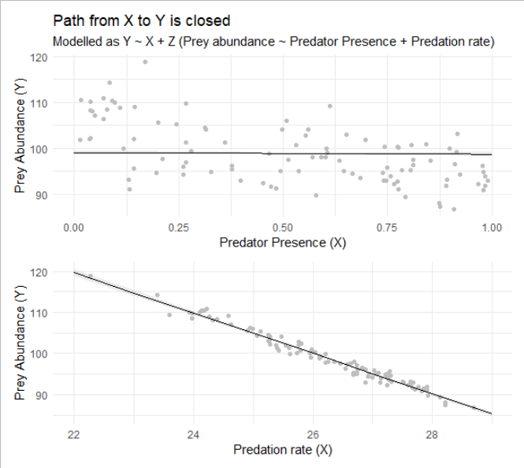
Piped confound
Z
Z
X
Y
X
Y
Path is open
Path is closed

Slide 22




Piped confound quiz
Z
X
Y
causes (?)
$$Age→Growth rate→Height$$
If I am 3 years old, will I be short, medium or tall?
If we don’t want to underestimate the effect Age has on Height, we should not include Growth rate.
$$=$$
$$?$$
If you knew Z, would you still know that age influences height?

Slide 23
The confounds
Fork
Pipe
Z
Z
X
Y
X
Y
Collider
Descendant
Z
X
Z
Y
X
Y
V

Slide 24
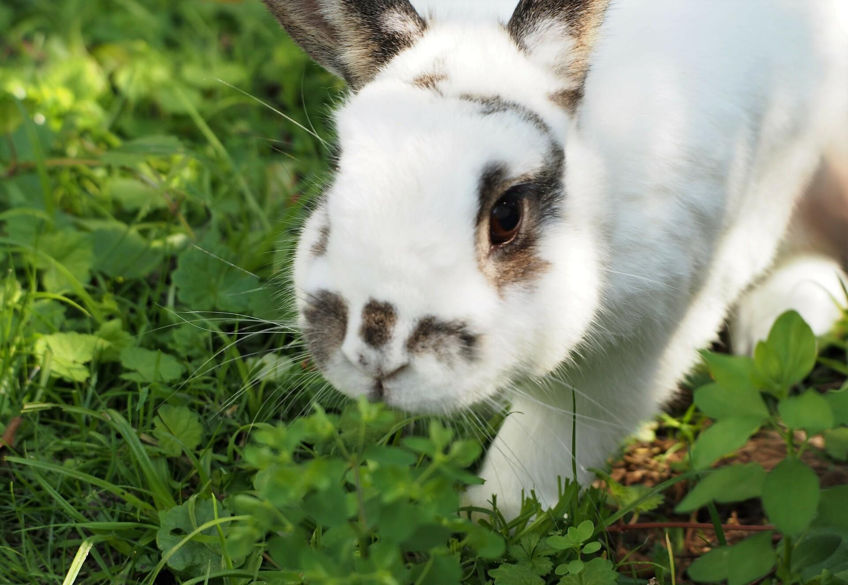
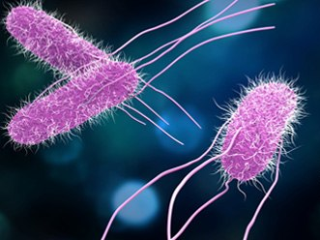
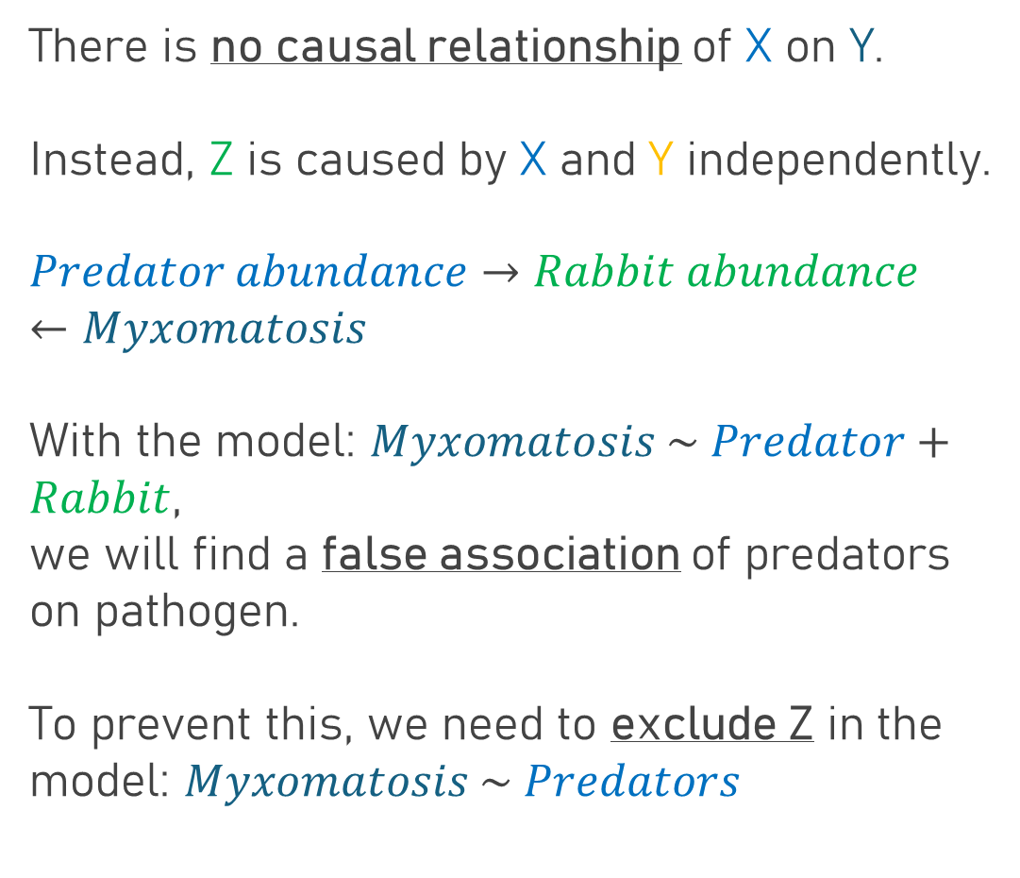
Colliding confound
Z
X
Y
There is no causal relationship of X on Y.
Instead, Z is caused by X and Y independently.
$$Predator abundance→Rabbit abundance←Myxomatosis$$
With the model: $Myxomatosis \sim Predator+Rabbit$,
we will find a false association of predators on pathogen.
To prevent this, we need to exclude Z in the model: $Myxomatosis \sim Predators$

Slide 25
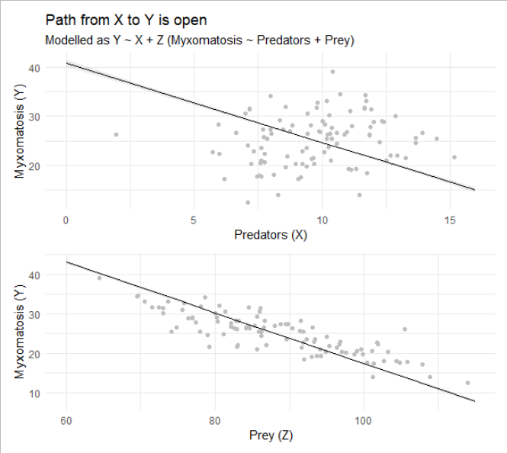
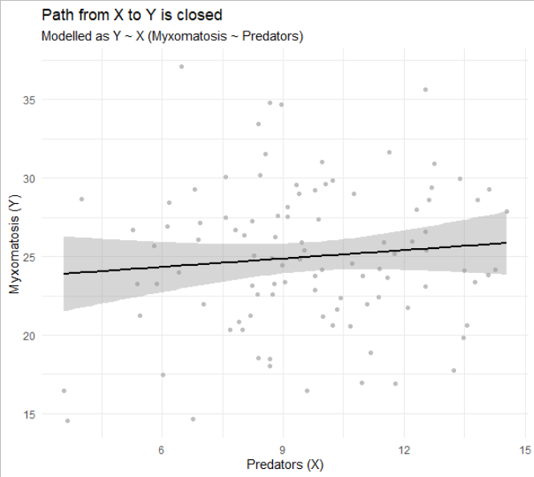
Colliding confound
Z
Z
X
Y
X
Y
Path is open
Path is closed

Slide 26




Colliding confound quiz
Z
X
Y
$$Restaurant Location→In business ←Quality of Food$$
causes (?)
If my restaurant is in a good location, will my food be good?
If we don’t want to misinterpret Location as causing Quality of Food, we should not know about if the restaurant is still in business.
$$=$$
$$?$$
Do you need to know Z to know that Location does not influence the Quality of Food?

Slide 27

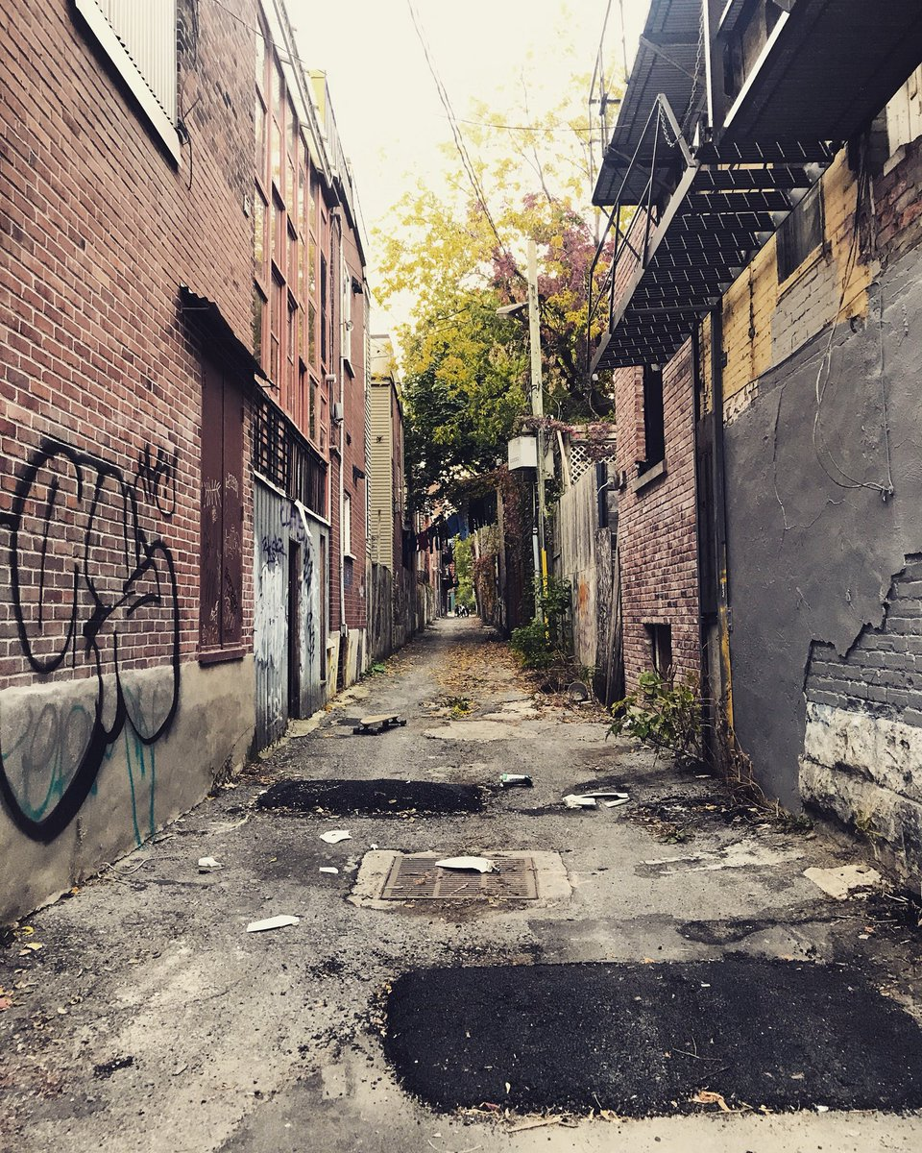
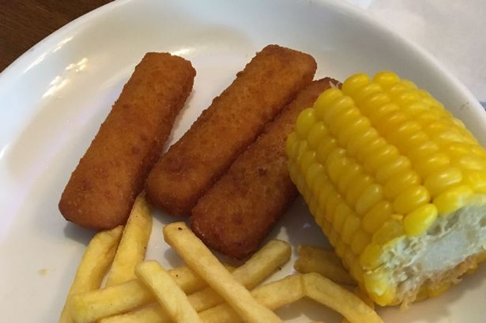
Why would we misinterpret a collider?
Z
X
Y
In business
Bad location
Good or bad food?
When you know X and Z, you always know Y.
Models find this association and we might interpret it as causation.

Slide 28
The confounds
Fork
Pipe
Z
Z
X
Y
X
Y
Collider
Descendant
Z
X
Z
Y
X
Y
V

Slide 29
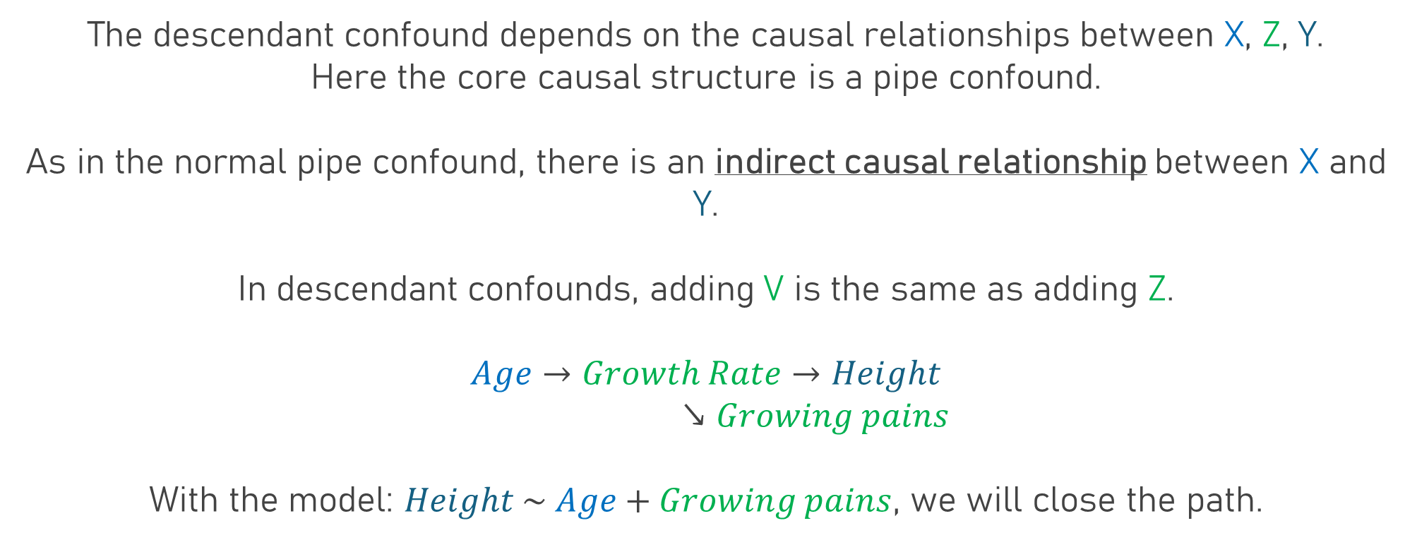
Descendant confound
X
Z
Y
V
The descendant confound depends on the causal relationships between X, Z, Y.
Here the core causal structure is a pipe confound.
As in the normal pipe confound, there is an indirect causal relationship between X and Y.
In descendant confounds, adding V is the same as adding Z.
$$Age→Growth Rate→Height$$
$↘Growing pains$
With the model: $Height \sim Age+Growing pains$, we will close the path.

Slide 30
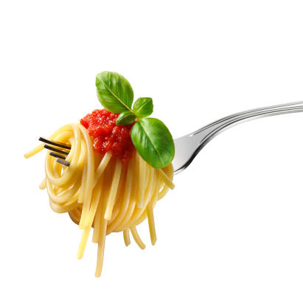
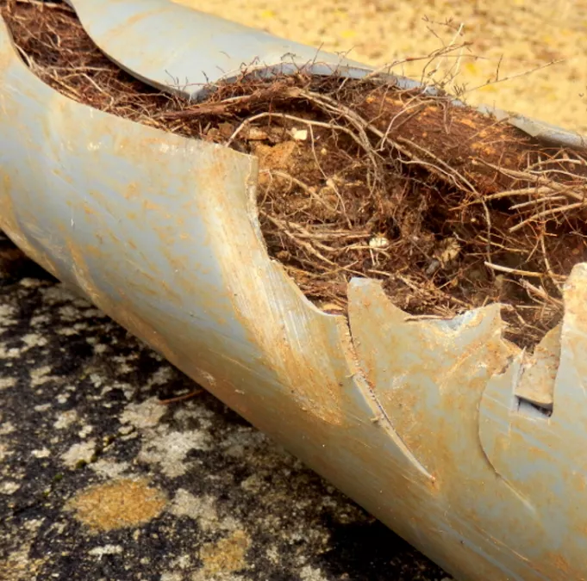
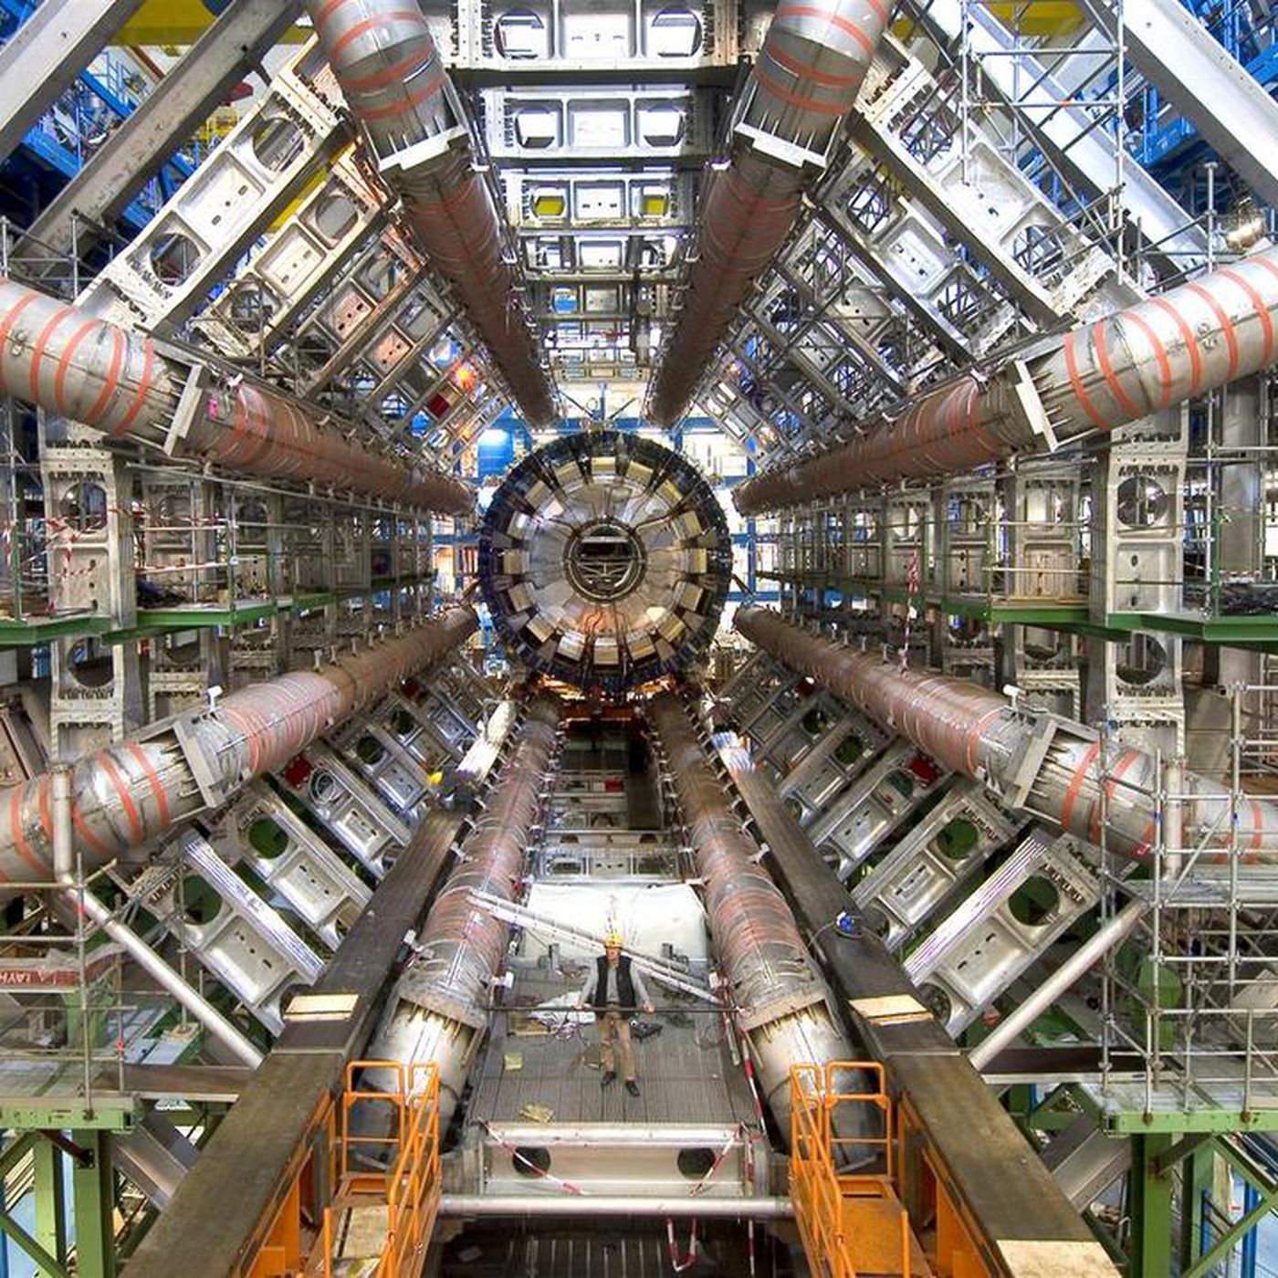


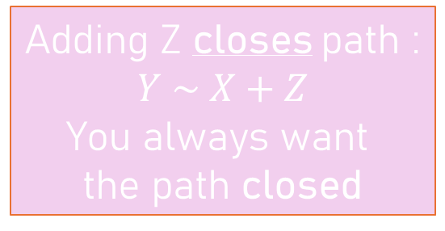
What about when X and Y are causally related?
Close the path
Open the path
Fork
Pipe
Adding Z closes path :
$$Y \sim X+Z$$
You always want
the path closed
Excluding Z opens path:
$$Y \sim X$$
You almost always
want the path open
Z
Z
X
Y
X
Y
Collider
Descendant
Excluding Z
closes path:
$$Y \sim X$$
You always want
the path closed
Treat V as another version of Z. Look at the triplet structure of X, Z, Y and proceed.
Z
X
Z
Y
X
Y
V

Slide 31
How do we stop ourselves from being mislead?

Slide 32
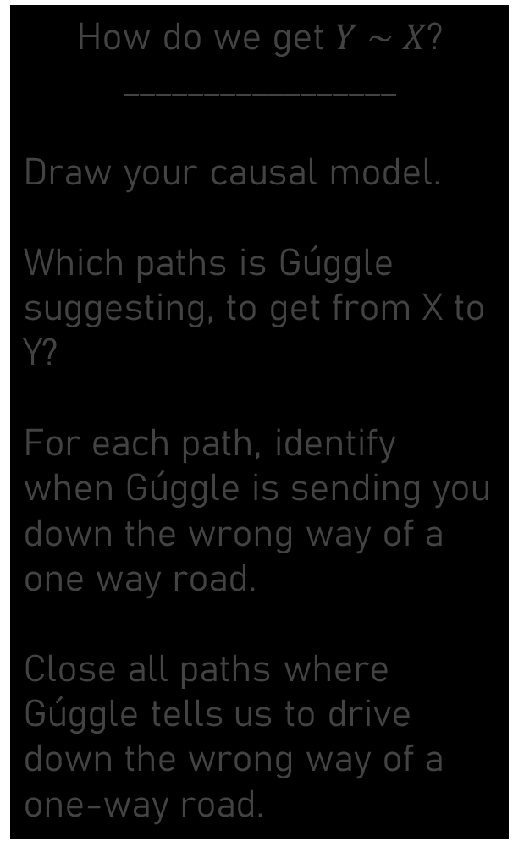
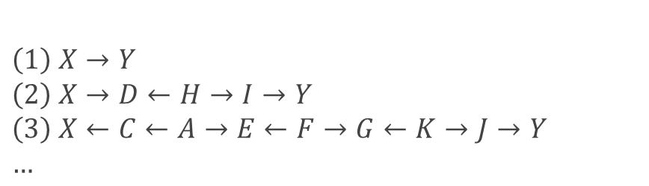
Hey Gúggle. How do I get to London?
How do we get $Y \sim X$?
_________________
Draw your causal model.
Which paths is Gúggle suggesting, to get from X to Y?
For each path, identify when Gúggle is sending you down the wrong way of a one way road.
Close all paths where Gúggle tells us to drive down the wrong way of a one-way road.
$$\left(1\right) X→Y$$
$$\left(2\right) X→D←H→I→Y$$
$$\left(3\right) X←C←A→E←F→G←K→J→Y$$
$$…$$
B
H
O
A
C
D
I
N
E
X
Y
J
M
F
G
K
L

Slide 33
Identify all paths of information flow
Path 1
Path 2
Path 3
D
I
D
I
D
I
X
Y
X
Y
X
Y
G
G
G

Slide 34
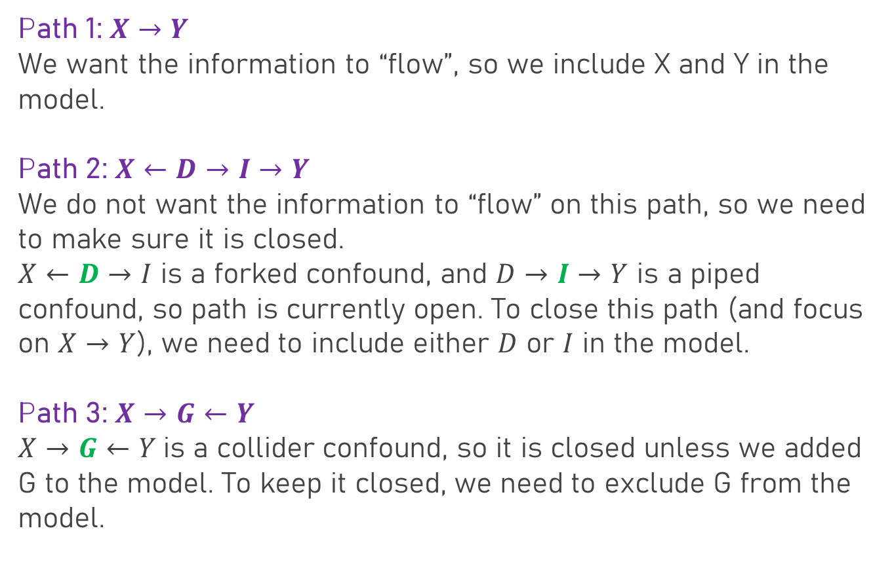

Close all backdoor paths of information flow
Path 1:$X→Y$
We want the information to “flow”, so we include X and Y in the model.
Path 2:$X←D→I→Y$
We do not want the information to “flow” on this path, so we need to make sure it is closed.
$X←D→I$ is a forked confound, and $D→I→Y$ is a piped confound, so path is currently open. To close this path (and focus on $X→Y$), we need to include either $D$ or $I$ in the model.
Path 3:$X→G←Y$
$X→G←Y$ is a collider confound, so it is closed unless we added G to the model. To keep it closed, we need to exclude G from the model.
D
I
X
Y
G
The model we should run:
$$Y \sim X+D$$
Or
$$Y \sim X+I$$

Slide 35

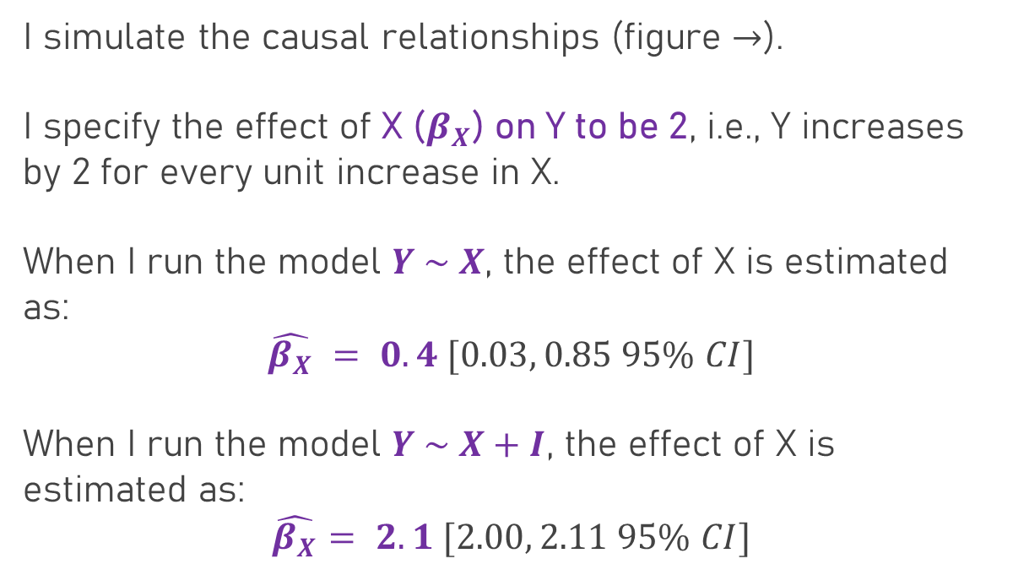
How well does our approach work?
D
I
I simulate the causal relationships (figure $→$).
I specify the effect of X ($β_{X}$) on Y to be 2, i.e., Y increases by 2 for every unit increase in X.
When I run the model $Y \sim X$, the effect of X is estimated as:
$$\hat{β_{X}} = 0.4 [0.03, 0.85 95\% CI]$$
When I run the model $Y \sim X+I$, the effect of X is estimated as:
$$\hat{β_{X}}= 2.1 [2.00, 2.11 95\% CI]$$
X
Y
G
The model we should run for the direct effect of X on Y:
$$Y \sim X+D$$
Or
$$Y \sim X+I$$

Slide 36
We see the tip of the iceberg if we’re lucky
Most research is done without considering confounds. If you’re lucky, you may know one confound.
Variables are generally thrown into models with a belief that there will be some sort of causal relationship.
This is incredibly dangerous.
Are you opening a confounded path by adding it to the model or closing it.
See the covid latitude paper on MyAberdeen
B
H
O
B
H
O
C
D
A
C
D
I
N
A
I
N
M
E
X
Y
J
M
E
X
Y
J
F
G
K
L
F
G
K
L

Slide 37





Can we study the direct effect of X on Y here?
X
A
This direct causal relationship between X and Y cannot be analysed without being confounded by either the pipe, or the collider.
B
Y
$$\left(1\right):X→Y$$
This is the relationship of interest, so: $Y \sim X$
$$\left(2\right):X→A→Y$$
$A$ is a pipe, so if we want to close: $Y \sim X+A$
$$\left(3\right):X→A←B→Y$$
$A$ is a collider, so to close path remove $A$: $Y \sim X$

Slide 38
How do you protect yourself?
Use your biological training
Draw diagrams where you show proposed chains of causation
Figure out which paths need to be blocked
Use this to collect your data and build your models
It can help avoid doing impossible research
Don’t throw variables in and claim everything is “controlled”
Don’t ignore confounds and claim everything is causal

